Slide 1
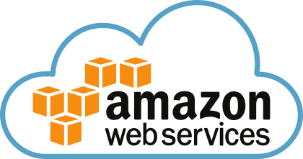
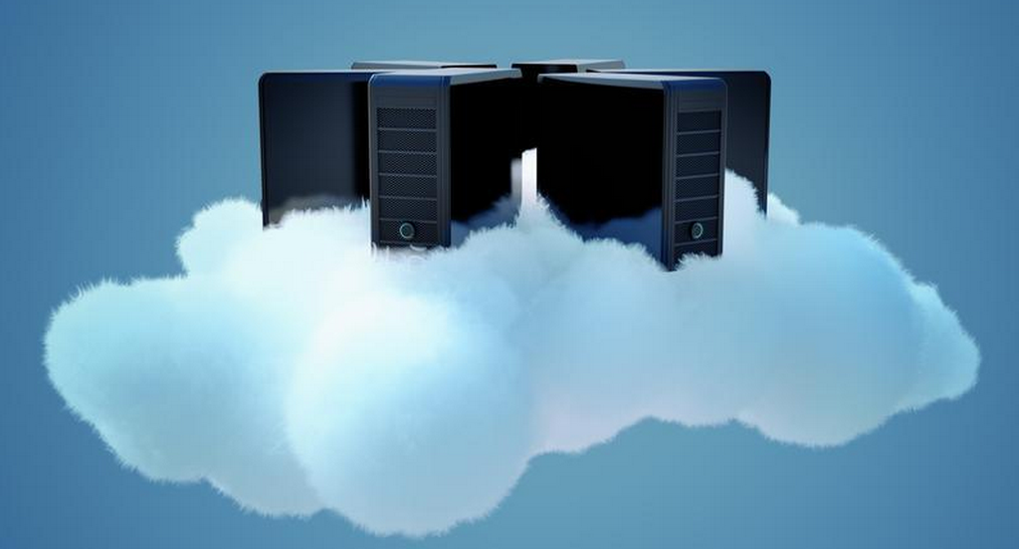

AWS Training - Session 7
Dr. Prabhakar PhD
Senior Integration Engineer
Decision Minds, Bengaluru.

Slide 2
Contents
AWS Direct Connect
AWS RDS

Slide 3
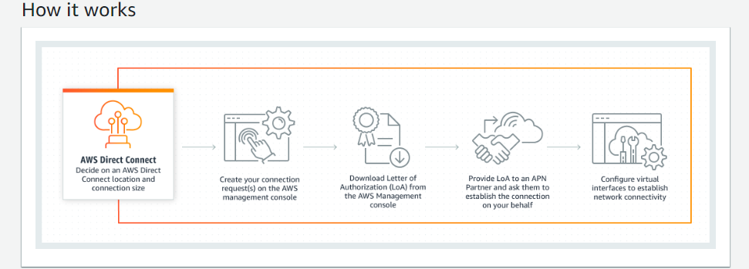
AWS Direct Connect
1 gigabit to 10 gigabit Ethernet fibre optic cable
Network and Content Delivery Service

Slide 4
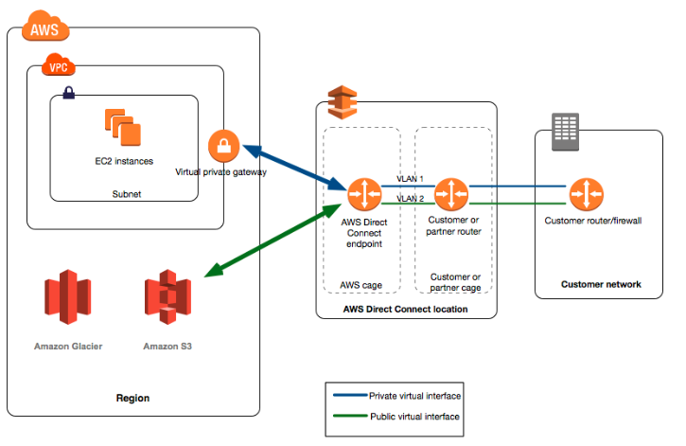
AWS Direct Components
Connection in an AWS Direct Connect location to establish a network connection from your premises to an AWS Region.
A public virtual interface enables access to public services, such as Amazon S3. A private virtual interface enables access to your VPC.

Slide 5
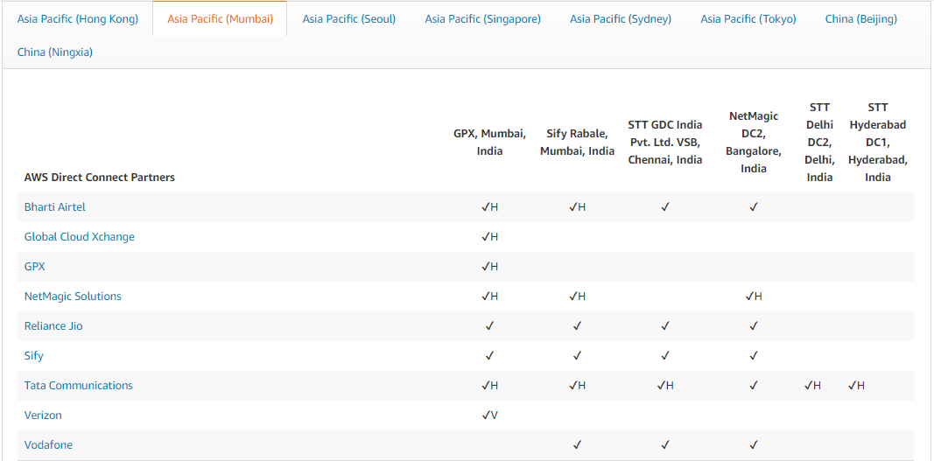
AWS Direct Connect Partners

Slide 6
AWS Direct Connect Gateway is a service built on top of the AWS Direct Connect. It allows AWS Direct Connect users to connect multiple VPCs in the same or different AWS regions to their Direct Connect connection.
The Direct Connect Gateway sits between the Direct Connect locations and customer VPCs.
VPCs distributed across regions are connected to the Direct Connect Gateway via a Virtual private Gateway.
Direct Connect Gateways are in turn connected to AWS Direct Connect connection over a virtual private interface.
Use Cases:
Working with Large Data sets
Real time data feeds
Hybrid environments

Slide 7
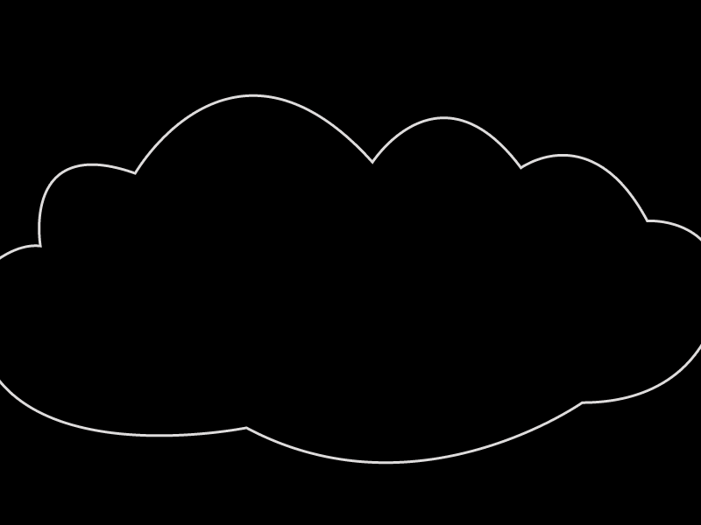
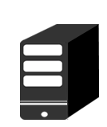
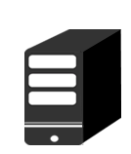
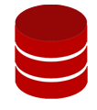
AWS RDS
Load Balancer
Easy set up
Easy scalability
Easy high availability (automatic failover)
Easily securable
Automatic backups
Automatic patches
Master
R
R
R

Slide 8
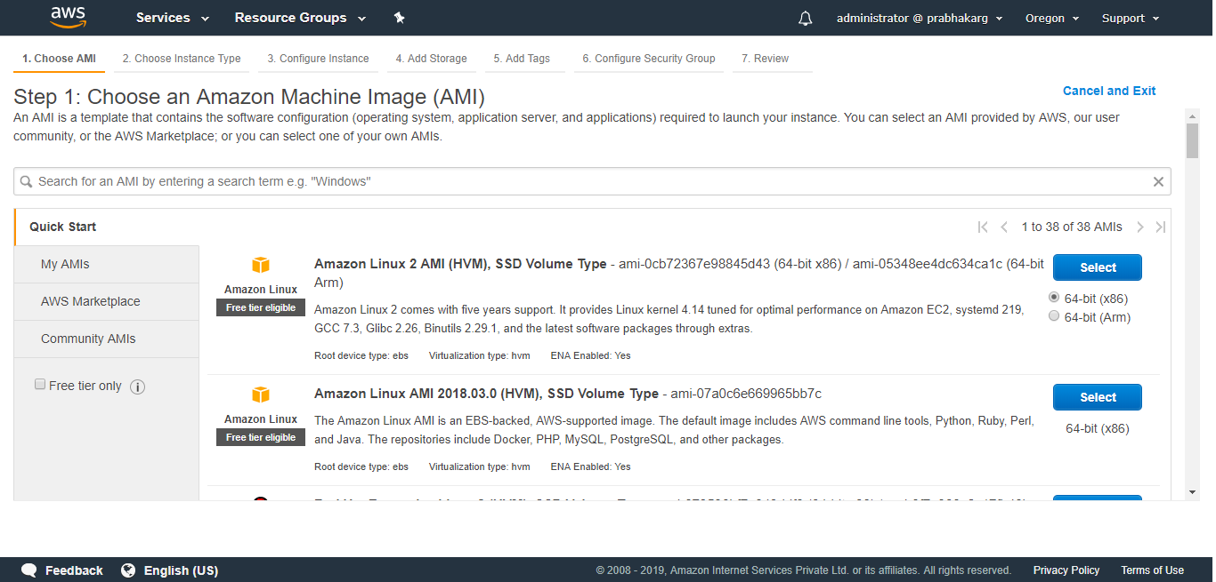
Creating Application server

Slide 9
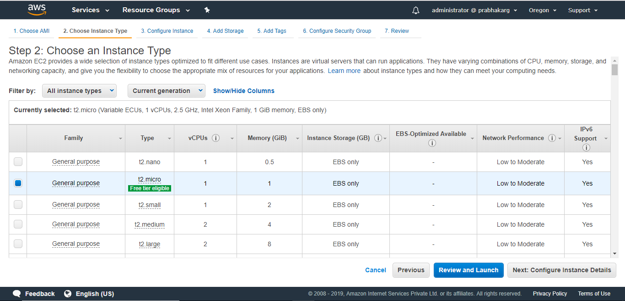

Slide 10
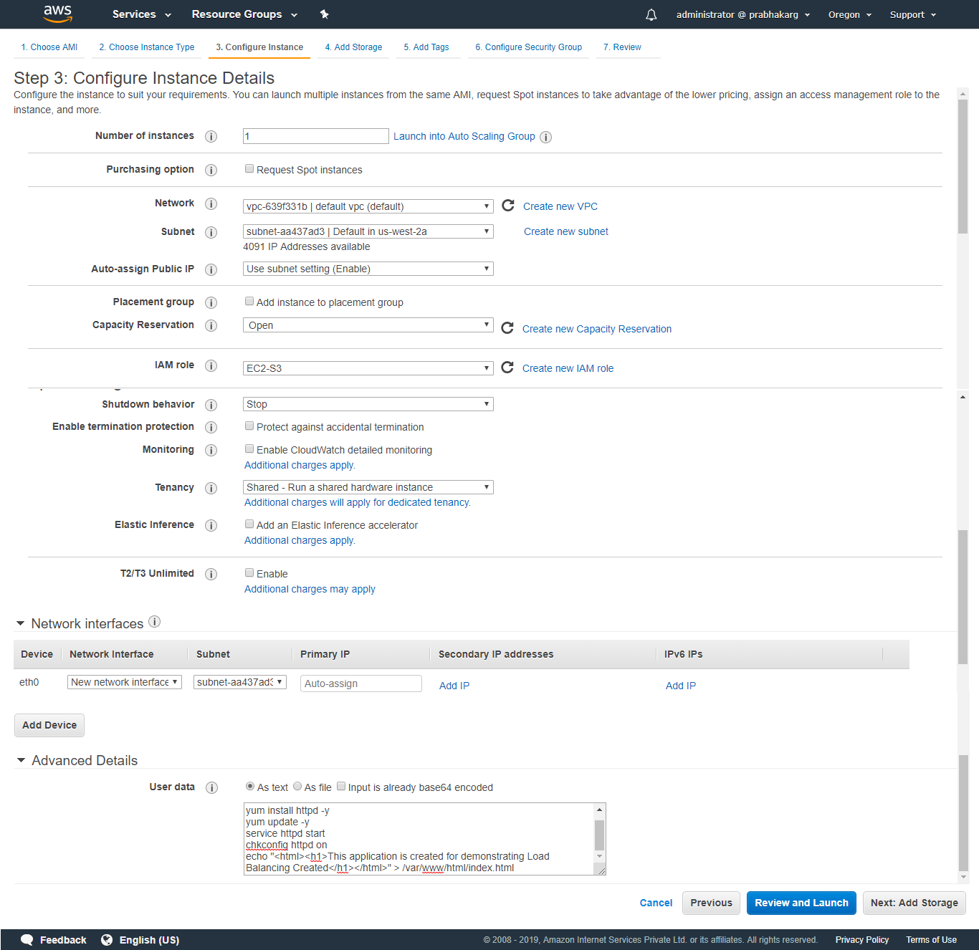

Slide 11
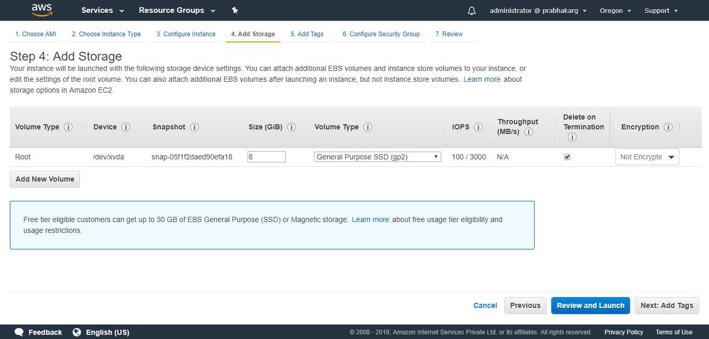

Slide 12
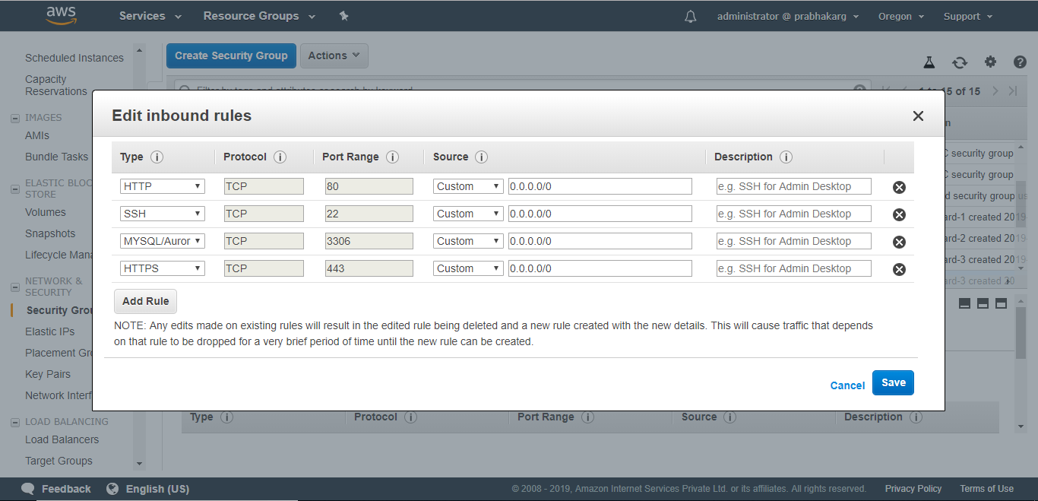

Slide 13
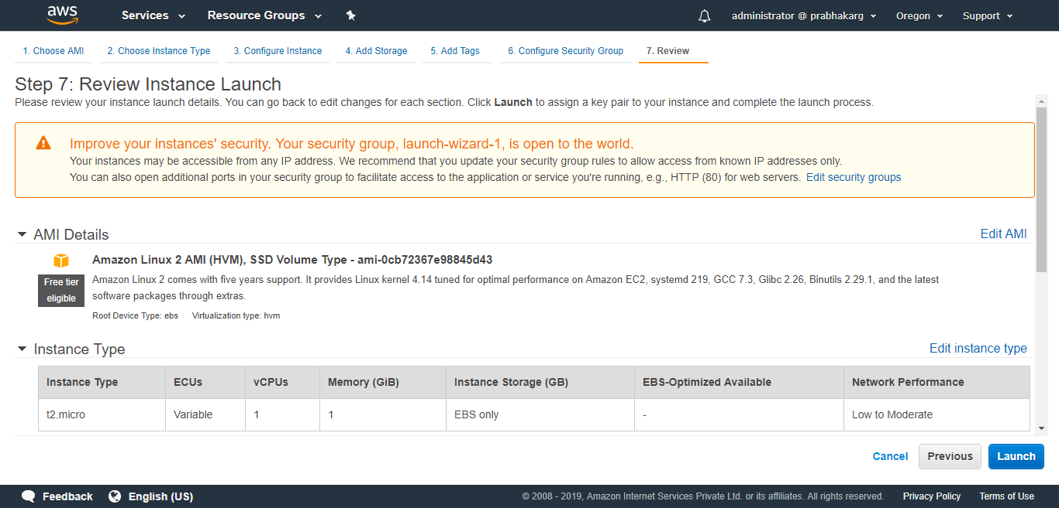

Slide 14
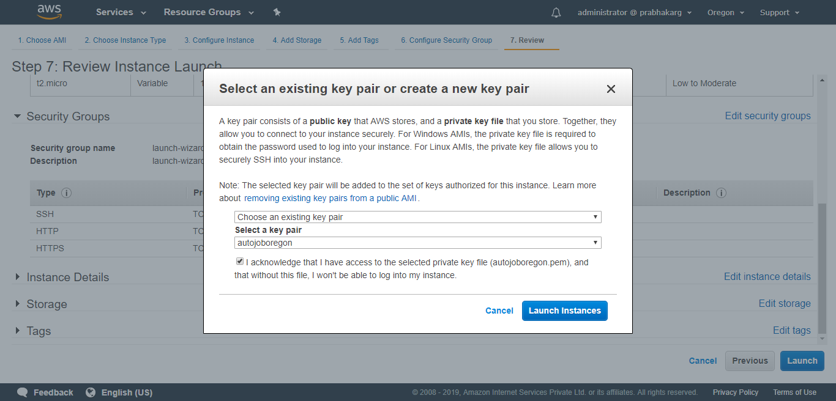

Slide 15
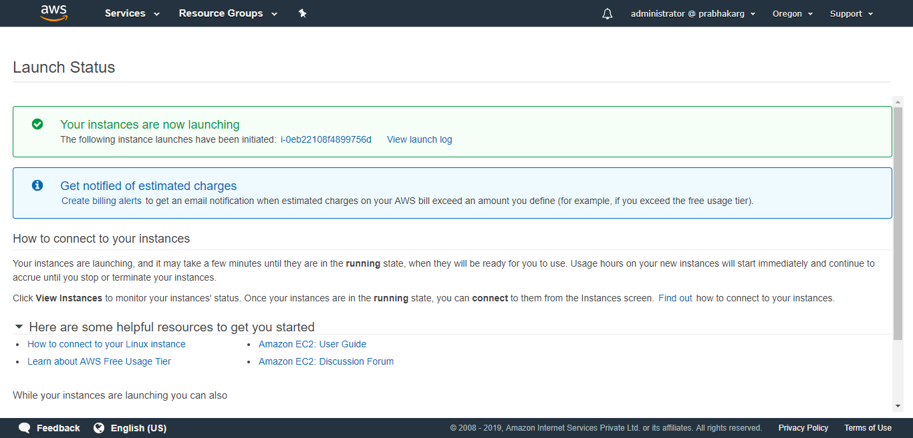

Slide 16
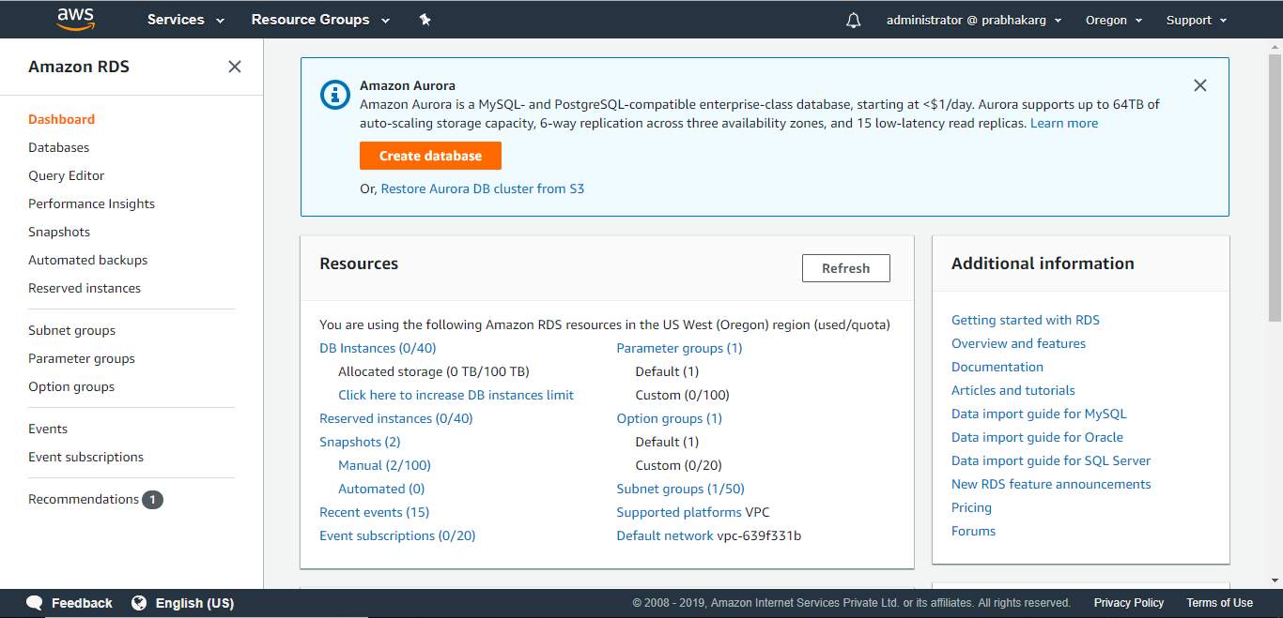
Creating Database server

Slide 17
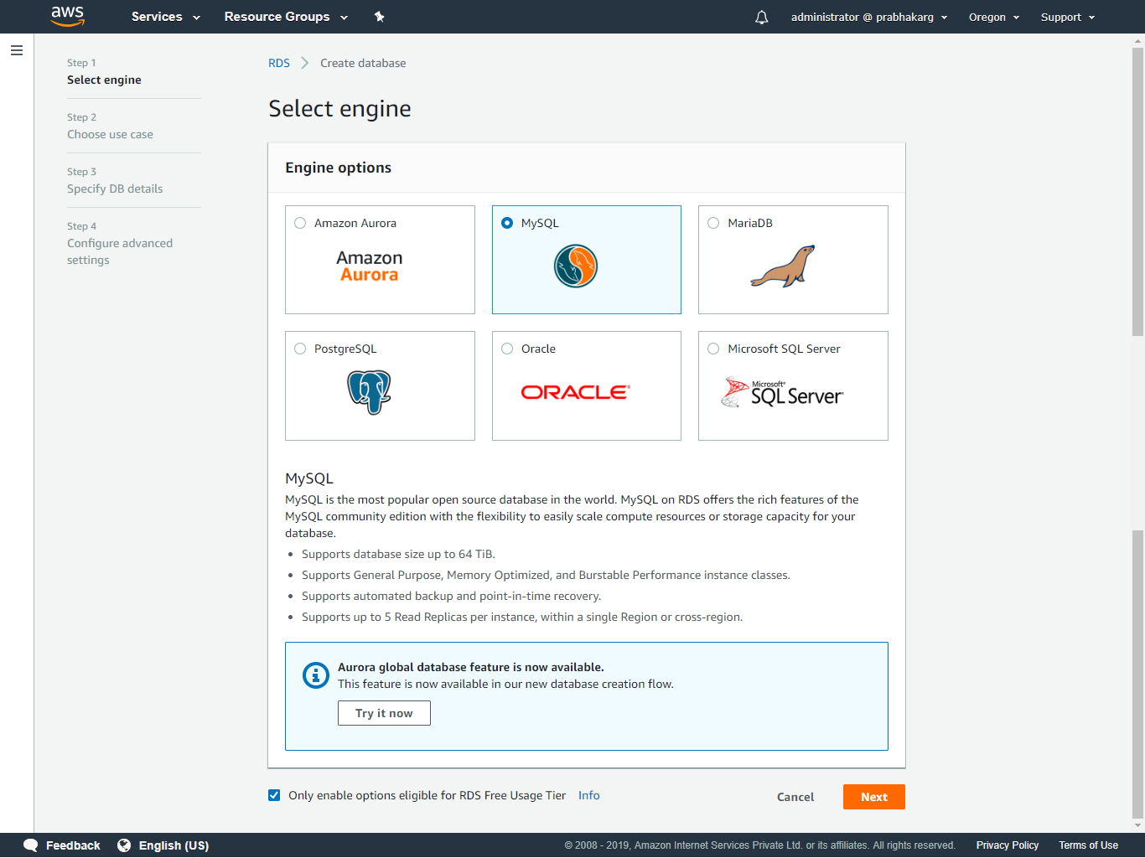

Slide 18
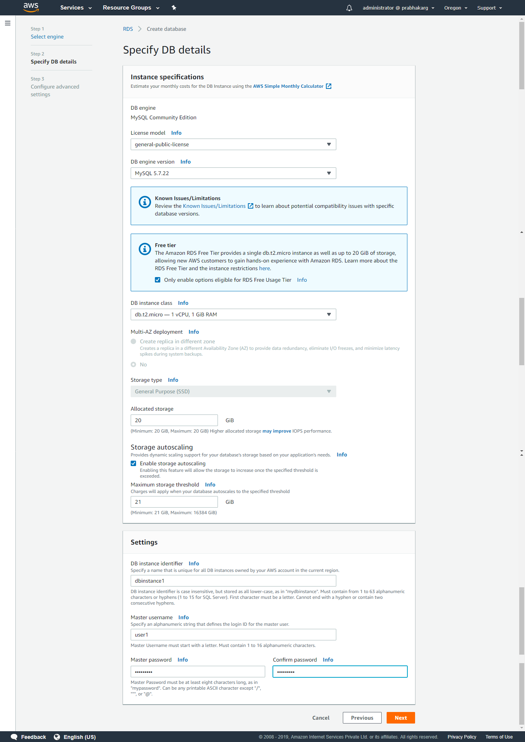

Slide 19
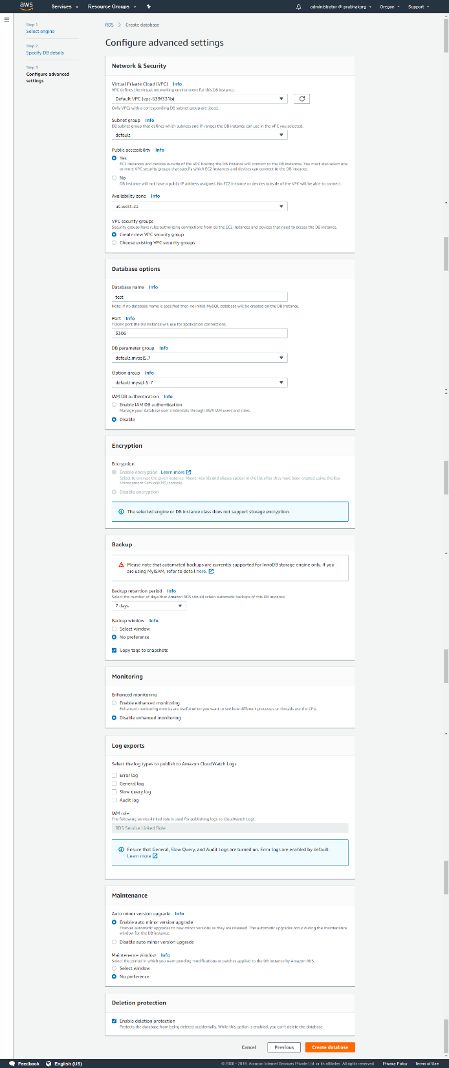

Slide 20
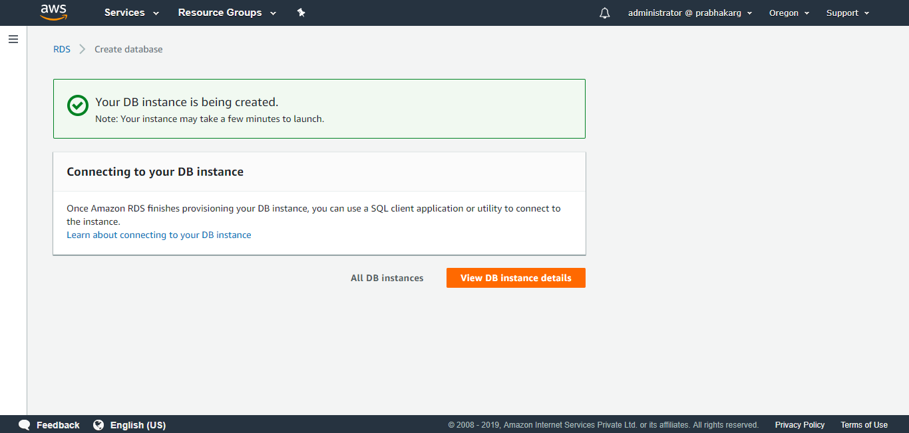

Slide 21
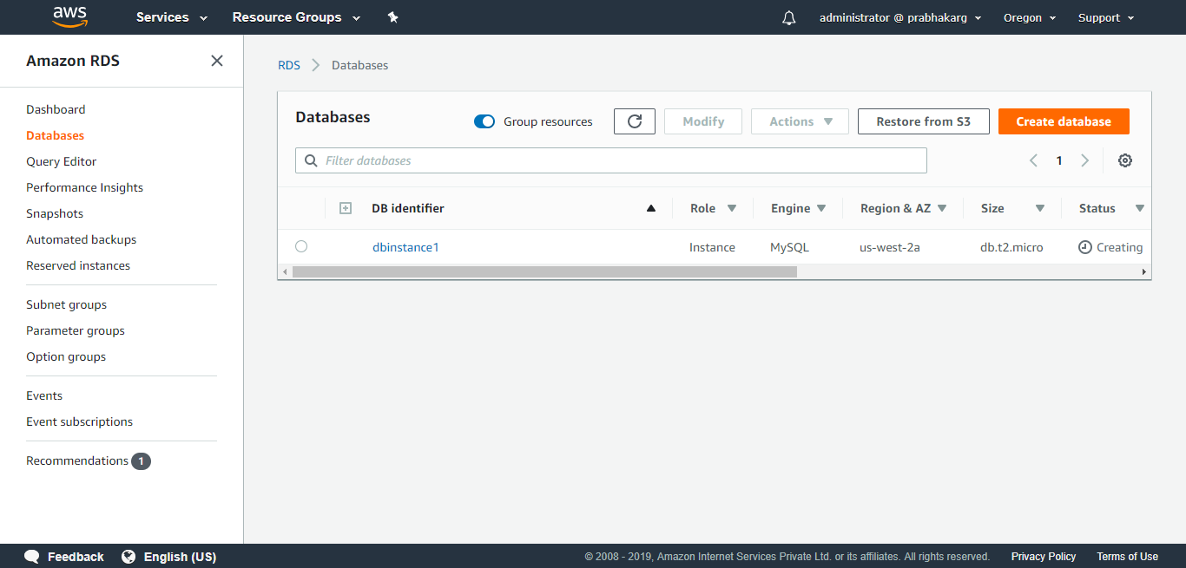

Slide 22
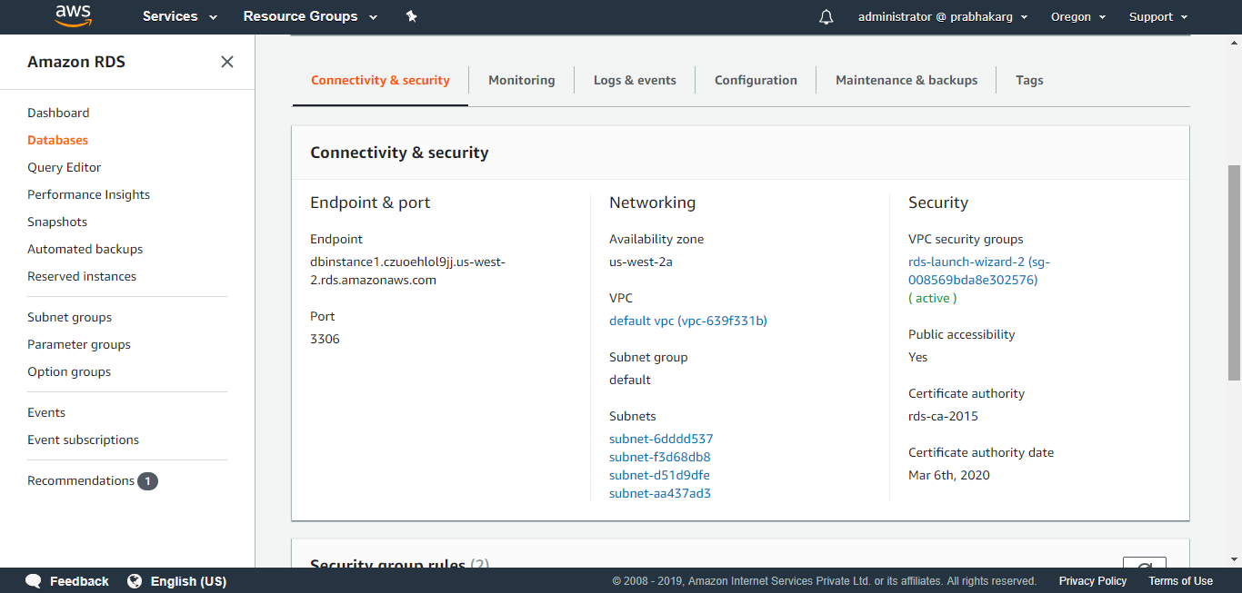

Slide 23
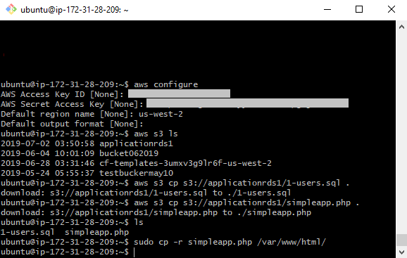

Slide 24


Slide 25
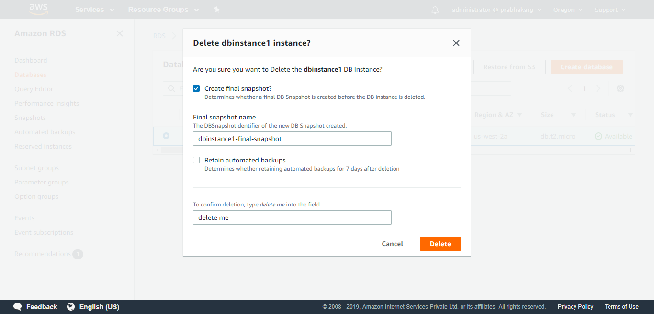

Slide 26
Thank You

